Slide 1
Machine Learning Supervised Learning
Instructor: Zainab Yousuf

Slide 2
Content
Machine Learning (Review)
Types of Machine Learning (Review)
Difference between Classification and regression
What is Classification

Slide 3

Machine learning
“Machine learning denotes automated changes in an AI system that are adaptive in the sense that they enable the system to do the same task (or tasks drawn from a population of similar tasks) more effectively the next time”

Slide 4
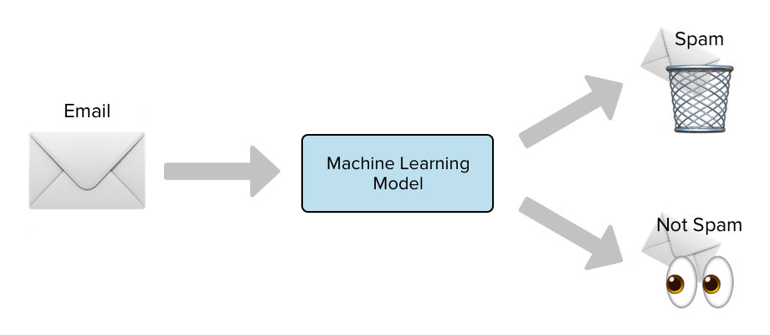

Example of Machine Learning
Example#1:
T: Categorize email messages as spam or legitimate.
P: Percentage of email messages correctly classified.
E: Database of emails, some with human-given labels

Slide 5
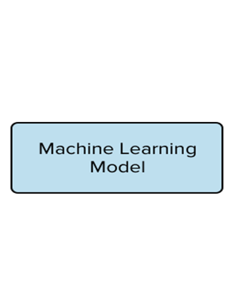
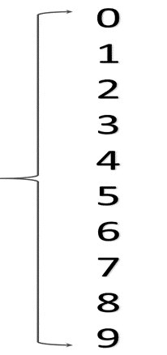
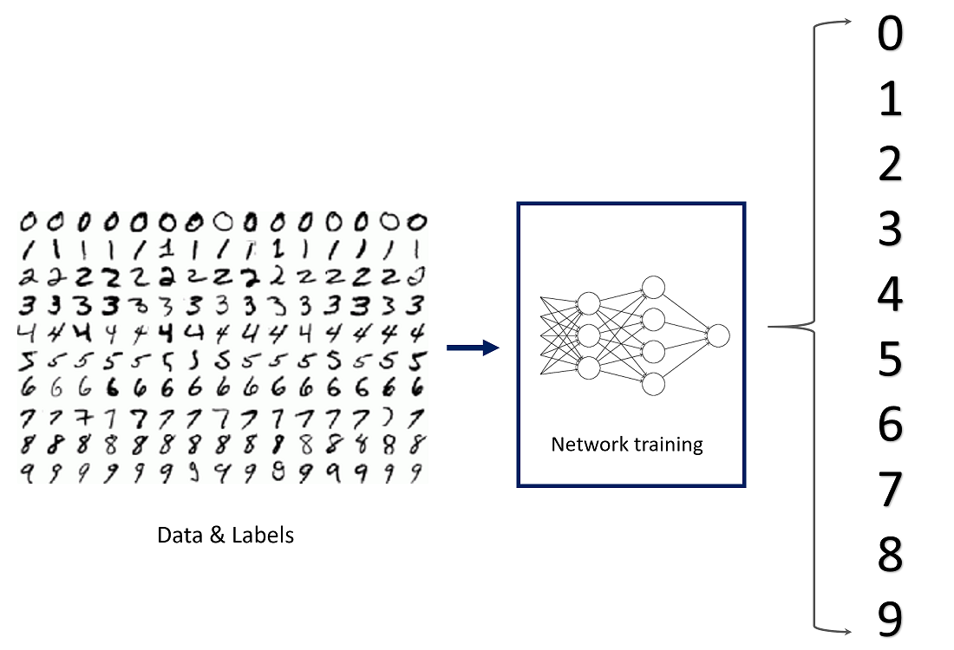
Example of Machine Learning
Example#2:
T: Recognizing hand-written digits
P: Percentage of digits correctly classified
E: Database of human-labeled images of handwritten digits

Slide 6
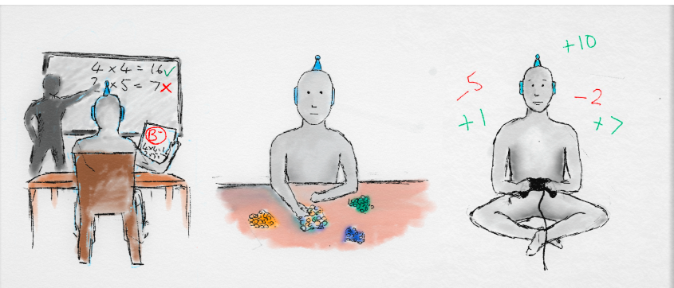
Categories of Machine Learning
Machine learning algorithms are often categorized as follows:
Supervised Learning
Unsupervised Learning
Reinforcement Learning
Sometimes Semi-supervised also

Slide 7
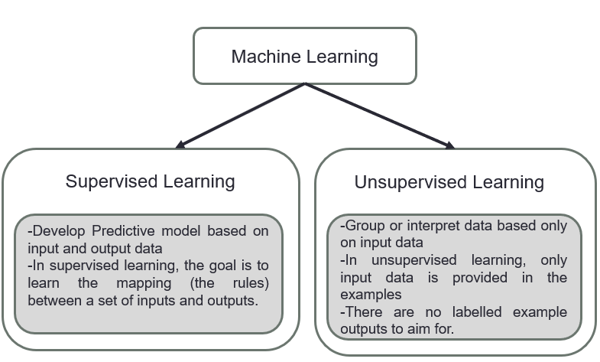
Supervised VS Unsupervised Machine Learning

Slide 8
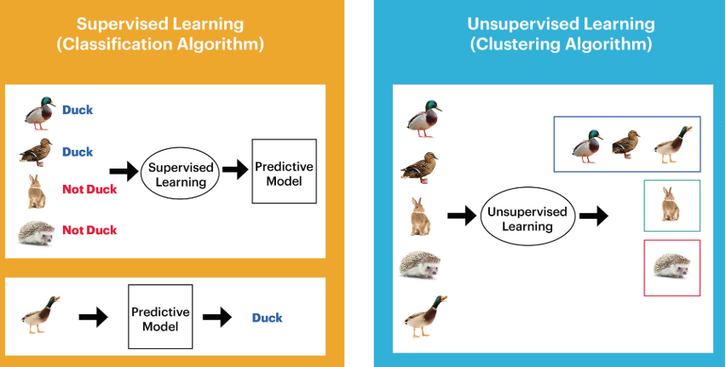
Example of Supervised VS Unsupervised Machine Learning

Slide 9
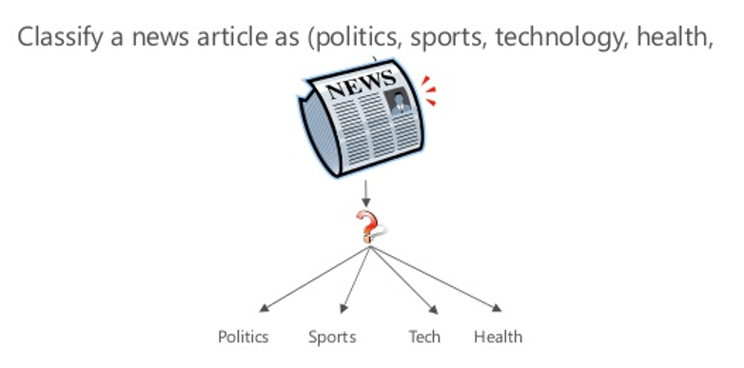
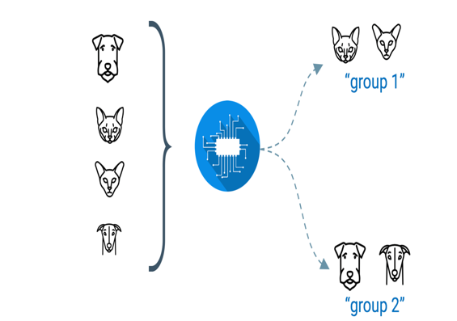
Example of Supervised VS Unsupervised Machine Learning
Supervised
Unsupervised

Slide 10
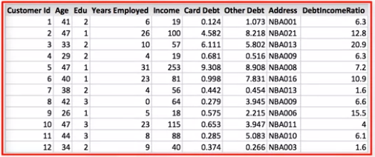
Example of Supervised VS Unsupervised Machine Learning
Supervised
Unsupervised

Slide 11
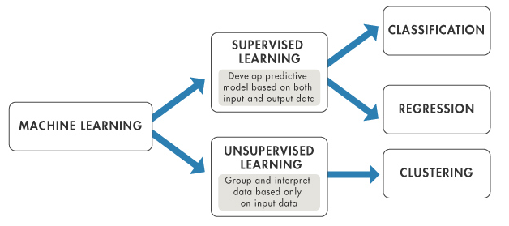
Supervised VS Unsupervised Machine Learning

Slide 12
Classification
Classification predictive modelling is the task of approximating a mapping function (f) from input variables (X) to discrete output variables (y).
The output variables are often called labels or categories. The mapping function predicts the class or category for a given observation.
For example, an email of text can be classified as belonging to one of two classes: “spam“ and “not spam“.
A classification problem requires that examples be classified into one of two or more classes.
A classification can have real-valued or discrete input variables.
A problem with two classes is often called a two-class or binary classification problem.
A problem with more than two classes is often called a multi-class classification problem.
A problem where an example is assigned multiple classes is called a multi-label classification problem.

Slide 13
Classification
Classification is a process of categorizing a given set of data into classes
The classes are often referred to as target, label or categories
C=(C1,C2….Cm)
(Iris Setosa & Iris versicolor in iris flower dataset)
Each data sample is represented by an n-dimensional feature vector,
X = (x1, x2, … xn)
(sepal_width, sepal_length, petal_width, petal_length in iris flower dataset)
The classifier calculates the probability of data sample (unknown/new) w.r.t each class/category.
The classifier decides the class on the basis of highest priority
if P(Ci|X) > P(Cj|X) for 1 ≤ j ≤ m , j ≠ i then X is assigned to Ci

Slide 14
Classification
For example, Heart disease detection can be identified as a classification problem,
This is a binary classification since there can be only two classes i.e.
Class1: has heart disease
Class2: does not have heart disease.
The classifier, in this case, needs training data to understand how the given input variables are related to the class.
Once the classifier is trained accurately, it can be used to detect whether heart disease is there or not for a particular patient.

Slide 15
Regression
Regression predictive modelling is the task of approximating a mapping function (f) from input variables (X) to a continuous output variable (y).
A continuous output variable is a real-value, such as an integer or floating point value. These are often quantities, such as amounts and sizes.
For example, a house may be predicted to sell for a specific dollar value, perhaps in the range of $100,000 to $200,000.
A regression problem requires the prediction of a quantity.
A regression can have real valued or discrete input variables.
A problem with multiple input variables is often called a multivariate regression problem.
A regression problem where input variables are ordered by time is called a time series forecasting problem.

Slide 16
Classification VS Regression
Classification predictive modelling problems are different from regression predictive modelling problems.
Classification is the task of predicting a discrete class label.
Regression is the task of predicting a continuous quantity.
There is some overlap between the algorithms for classification and regression; for example:
A classification algorithm may predict a continuous value, but the continuous value is in the form of a probability for a class label.
A regression algorithm may predict a discrete value, but the discrete value in the form of an integer quantity.
Some algorithms can be used for both classification and regression with small modifications, such as decision trees and artificial neural networks. Some algorithms cannot, or cannot easily be used for both problem types, such as linear regression for regression predictive modelling and logistic regression for classification predictive modelling.
Importantly, the way that we evaluate classification and regression predictions varies and does not overlap, for example:
Classification predictions can be evaluated using accuracy, whereas regression predictions cannot.
Regression predictions can be evaluated using root mean squared error, whereas classification predictions cannot.

Slide 17
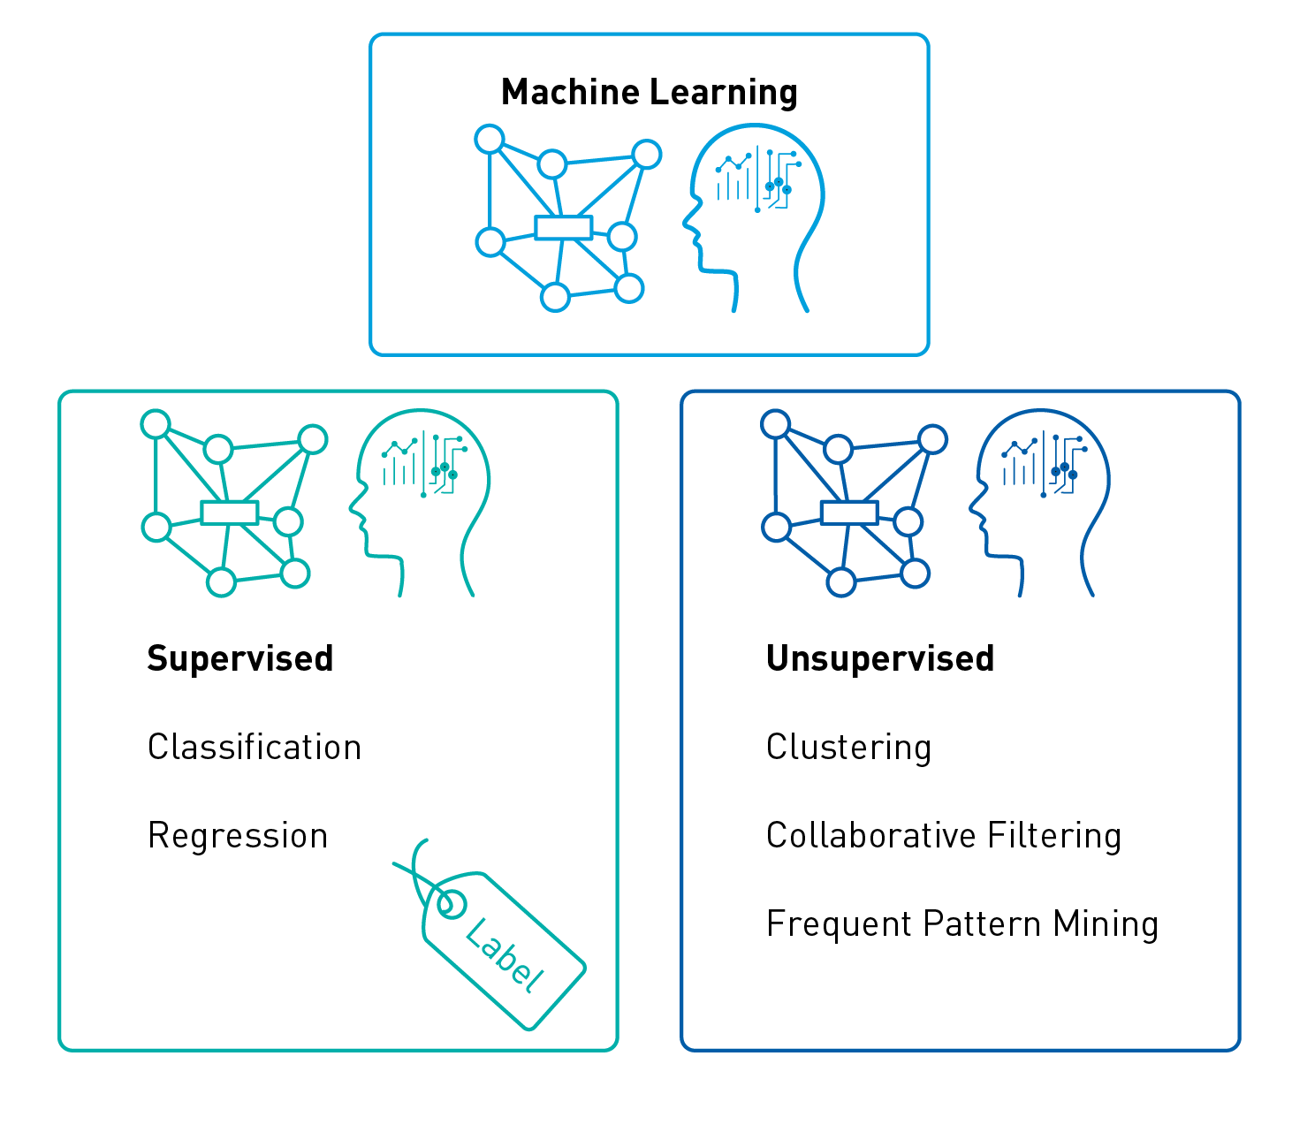
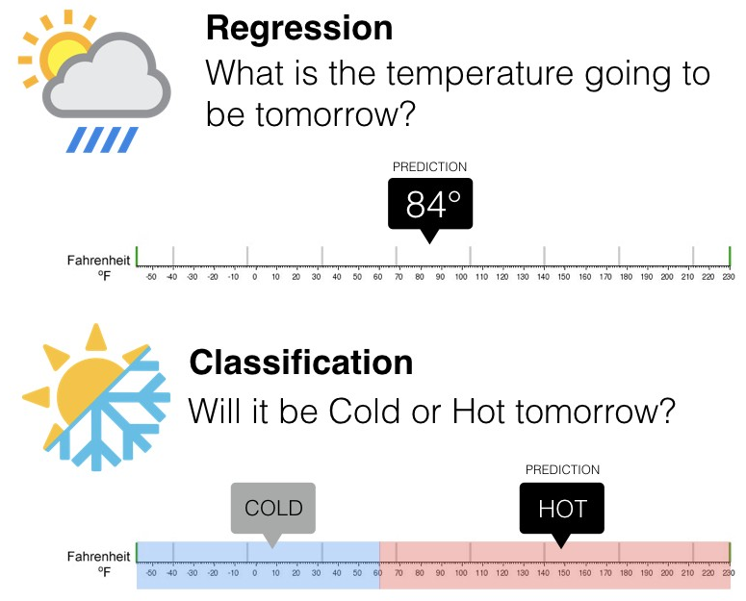
Classification VS Regression

Slide 18
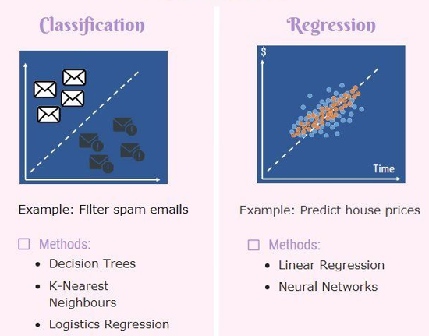
Classification VS Regression

Slide 19
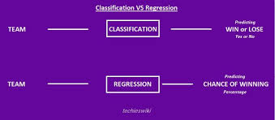
Classification VS Regression

Slide 20
Selection of Machine Learning Algorithm
There are dozens of supervised and unsupervised machine learning algorithms, and each takes a different approach to learning.
There is no best method that fits all problems/tasks.
Finding the right algorithm is partly based on trial and error.
Choosing the right algorithm requires trading off one benefit against another,
Accuracy
Complexity
Speed

Slide 21
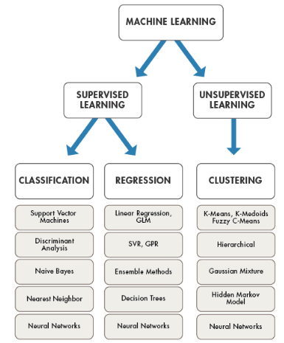
Selection of Machine Learning Algorithm
Naïve Bayes
Linear Regression
K-mean
Neural Network
Neural Network
Hierarchal
Nearest Neighbor
Decision Tree
Hidden Markov
Support Vector Machine
SVR
Gaussian Mixture
Discriminative Analysis
Ensemble Methods
Neural Network

Slide 22
Thank You

